Slide 1
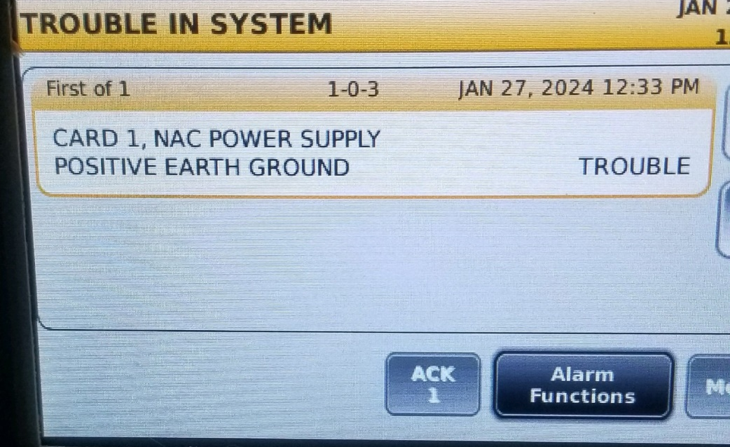
FIRE ALARM TROUBLE PROCEDURE
MAIN PANEL
A message on the screen like below means there is a problem with the fire alarm system. The panel will be sounding an alarm.
To silence the panel do the following.
Open the panel.
The “ACK 1” key will be lite up.
Press the “ACK 1” key and the panel should go quiet.
TURN PAGE OVER

Slide 2

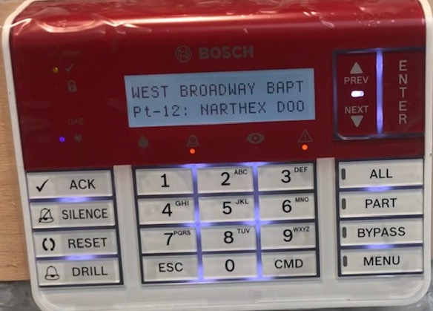
TROUBLE ALARM PROCEDURE
MAIN PANEL
The trouble message will remain on the screen.
Go to the security system key pad at door D-3.
Press The “ ACK” button to silence the security panels.
The yellow trouble light will remain on.

